Slide 1
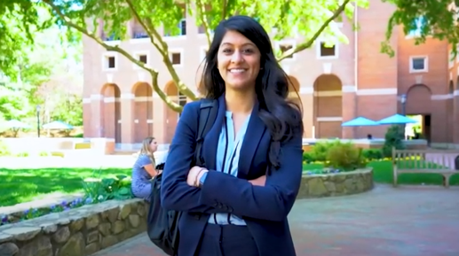
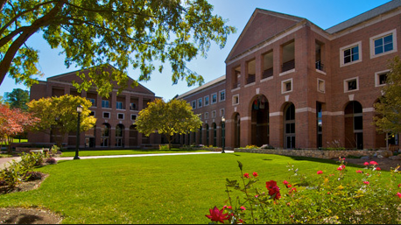
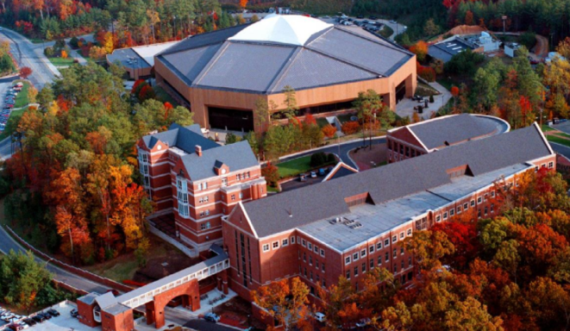
University of North Carolina at Chapel Hill
Why UNC Kenan Flagler? Why not? View Video
Kenan-Flagler Business School Campus

Slide 2
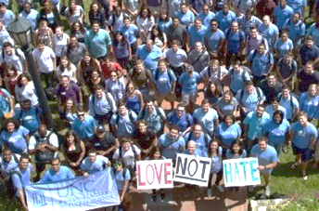
UNC Kenan-Flagler Business School
The University of North Carolina, Kenan-Flagler Business School
MBA Program, Global Programs
3oo Kenan Center Drive
McColl Building # 3490, Suite 2421
Chapel Hill, NC 27599
USA
MBA Exchange Program (inbound & outbound)
Associate Director, Patricia Collins
Patricia_Collins@kenan-flagler.unc.edu
Phone: +1 919 843 6965 (office)
Mobile: +1 919 696 6315
WhatsApp (mobile number)
WeChat: PatColUNC
LinkedIn: https://www.linkedin.com/in/patricia-collins-25816b/
Member of PIM Consortium (Partnership in International Management)
MBA Program Overview
Our MBAs Are Different Because We Are Different https://www.kenan-flagler.unc.edu/programs/mba/full-time-mba/
Our Core Values
Integrity, Inclusion, Innovation, Impact
Our Community
There’s so much more to an MBA program than what you learn in the classroom – the friends you meet, the clubs you join, the extracurricular activities you enjoy, the leadership skills you develop, and the professional contacts you make. At UNC Kenan-Flagler, these “extras” aren’t extra; they’re part of what our community is.
.

Slide 3
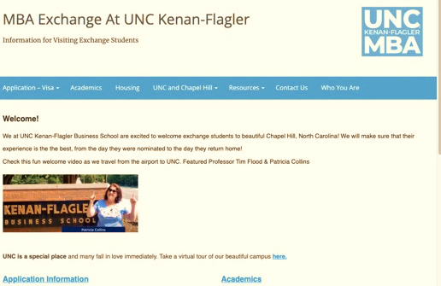
MBA Exchange Term Dates for 2022/23
Mod I
August 22 – October 13, 2022*
Mod II
October 24 – December 15, 2022*
Mod III
January 17 – March 3, 2023*
Mod IV
March 20 – May 5, 2023*
*including exams
Nomination process and dates for partner schools
For Fall Mod I & II terms:
Nomination deadline is April 1
For Spring Mod III & IV terms:
Nomination deadline is September 1
Simply email your nominations including student’s’ name, email address, and gender!
Exchange Program Website
Mandatory Orientation will take place 2-4 days before the start of each module

Slide 4
Expenses - Estimated Cost of Living
Exchange Program Expenses Estimates
General
Visa Application fee (F-1) $160
SEVIS fee (F-1) $350 Visa Interview Travel (depending where you live)
Per semester
Course Packs/Books $600 per semester
UNC Health Insurance $1300 per semester (international students can waive and bring their own)
Cost of Living Expenses Estimates Per month
Housing $700 on campus per student in 2-bedroom apt. (student housing, basic furniture)
WIFI, Electricity, water, included
Housing $1500 (off campus apartment) Furniture rental for off campus apartment, varies
Electricity off campus ~$100 WIFI/Internet $100
Food $600
Travel $150
Miscellaneous $200

Slide 5
MBA Academics
Curriculum & Courses
View below links to course lists, concentrations and curriculum
https://www.kenan-flagler.unc.edu/programs/mba/curriculum/course-offerings
https://public.kenan-flagler.unc.edu/applications/public/courses (courses by term & program)
https://www.kenan-flagler.unc.edu/programs/mba/curriculum
Grades
Grading System: H – High Pass; P – Pass; L – Low Pass, F - Fail. Students who have a Low Pass in more than 20 % of their courses will be academically ineligible. Exchange students fall under the same policy as our FT MBA students. Should a student receive an F, the home school will be notified and the student risks that their visa is in danger.
Course load & Credits
The MBA elective period (year 2) is divided into 4 modules( 2 in the fall and 2 in the spring). A student must enroll in a minimum of 3 courses and 4.5 elective credits per module to be considered full-time. For the semester exchange, this sums up to 9 elective credits and 6 courses. A student cannot take 2 courses in one module and 4 in the other, as the minimum course load has to be 3. We recommend students to not to take more than 5 courses per module. Only with approval can a student take 6 courses per module if he is required to do so by his home university.
Generally, a class consist of 20 in class contact hours and 30 out of class (study groups, case readings, etc.).
Transcript
A digital transcript will be automatically sent to the partner school’s international office who nominated their students. If the student has a stop/hold on their academic account, a transcript cannot be released.

Slide 6
MBA Global Program Support
Application Process
Visiting exchange students will receive support during their application process. Students need to submit online a current cv (resume), and a passport photo. Financial support documents as well as a passport copy are uploaded to an internal system once their application is complete.
Housing
There is limited availability for on campus housing. Shared 2-bedroom apartments are available. They are furnished with basic furniture. They are shared with another MBA exchange student, same gender. Assignments are done on a first come first served basis.
Campus Health
UNC Campus Health requires all students to have health insurance. Visiting exchange students can waive out of UNC’s insurance if their insurance policy covers UNC’s minimum requirements.
Immunizations are mandatory for all students entering the university.
Exchange students have access to campus health facilities and resources.
Onboarding
Orientation at the beginning of each term. 2 days of mandatory sessions covering legal services, health insurance, academics, honor code, class attendance policy and more!
Airport pick-up & Buddy program available

Slide 7
MBA Global Program Support
Career Resources
While on exchange students have access to various career management services, including:
Regular job search discussions: Exchange students will be invited to attend a number of career-related events on a regular basis, to discuss the US job search and field questions.
Sample Session Topics and Events:
Career exploration resources
Resume​
LinkedIn
Elevator pitch
Networking
Interviewing
Also:
Resume reviews and mock interview practice from the Business Communication Center
Participation in student Career Clubs, managed by the MBA Student Association (MBASA)
Company research databases
Access to Career & Leadership Coach Open Office Hours
Excluded from on campus career fairs as well as Kenan-Flagler’s resume book.

Slide 8
MBA Clubs – Open to Exchange Students
UNC Kenan-Flagler Career Clubs bring together students with a shared interest in an industry or function to educate, network and provide support in each student’s career exploration. This is accomplished through a variety of channels to include meetings, case competitions, conferences, career treks, mentoring, training, alumni networking, cross-club collaboration, international exposure and prospective student outreach.
Marketing
Net Impact
Private Equity
Real Estate
Sports & Entertainment
Business Technology
Consulting
Corporate Finance
Energy
EVC
Health Care
IB
Investment Management
and more…
UNC Kenan-Flagler Diversity Clubs
Asian Business Club Black Student Business Association
CWIB (Carolina Women in Business)
International Business Student Association
Jewish Business Association
Latin American Business Association
Pride
Christians@kenan-flagler
Veterans Association
And more …

Slide 9
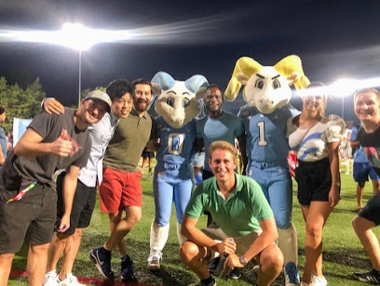
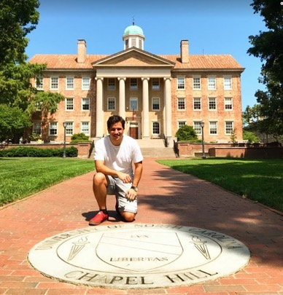
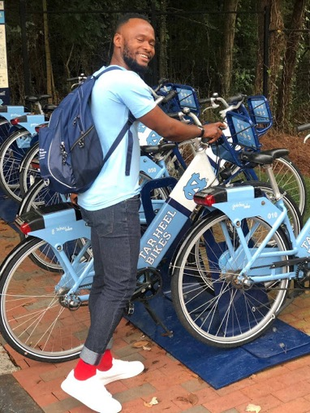
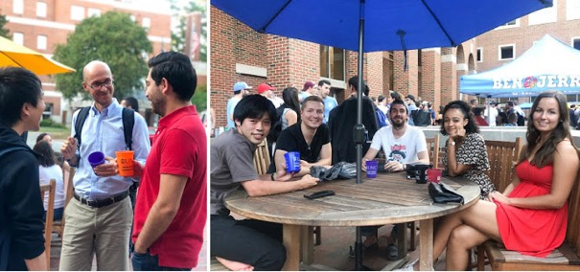
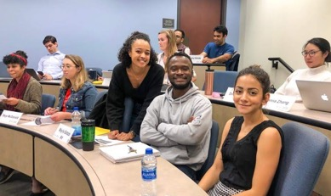
MBA Exchange Student Life

Slide 10
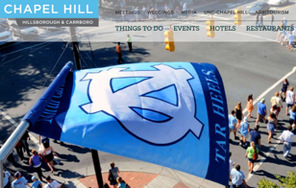
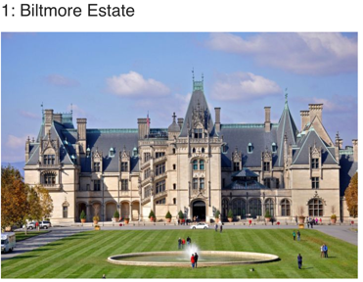
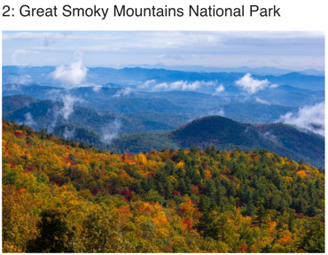
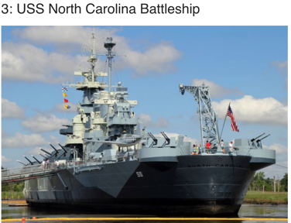
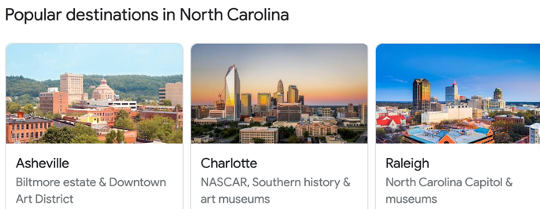
Chapel Hill Visitor Guide
Arts
Entertainment
Restaurants
Sports
Outdoor activities
Beautiful North Carolina – top 3 attractions

